Slide 1
Splash Technologies: Gender Pay Equity Analysis
Departmental Pay Disparities and Performance-Based Compensation Alignment
Leticia Mie Otani, People Analytics Consultant

Slide 2
Problem Statement & Hypothesis
Problem Statement
Splash Technologies demonstrates strong leadership diversity; however, pay equity remains inconsistent across departments. Preliminary analysis revealed gender-based salary disparities that, while modest overall, vary significantly by function.
Hypothesis
Gender-based pay differences are department-specific rather than company-wide, with IT/IS showing the most pronounced gap—particularly among high-performing female employees. Subsequent analysis validated this hypothesis, confirming inequitable pay distribution concentrated within IT/IS.

Slide 3
Data Cleaning & Key Metrics
Metric | Description | Value
Mean Gender Pay Gap | Average female-to-male salary difference | −4.9%
Departmental Gap (IT/IS) | Female “Exceeds” vs. Male “Exceeds” | −46.7%
Performance Alignment Ratio | Female “Exceeds” vs. “Fully Meets” | −13%
Pay Dispersion (SD) | M: CA$35,019 vs F: CA$20,889 | Higher variance for males
Observation: To ensure analytical integrity, the dataset was cleaned and refined—filling missing values, standardizing position IDs, and department assignments to enable accurate salary comparisons.

Slide 4
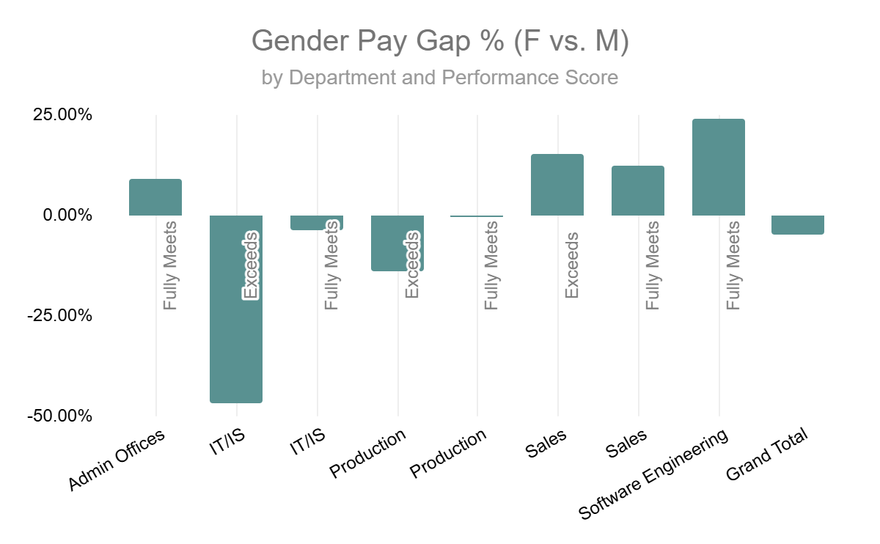
Gender Pay Gap % by Department
Insight: the chart shows uneven pay equity across departments. IT/IS displays the widest gap, where female top performers earn far less than their male counterparts. Other areas remain closer to parity, suggesting the issue is concentrated rather than systemic.

Slide 5
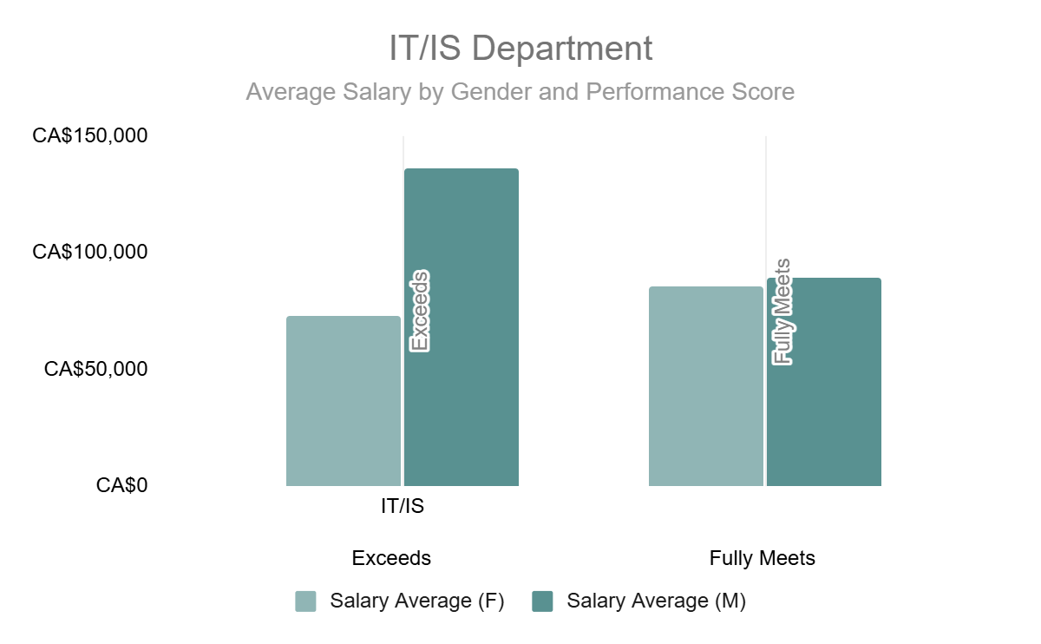
Pay Gap vs. Performance Alignment
Insight: Despite outperforming expectations, female “Exceeds” employees in IT/IS earn less than both their male peers and female “Fully Meets” performers. This indicates pay-for-performance misalignment rather than a universal gender gap.

Slide 6
Next Steps for Sustainable Pay Equity
Immediate Actions:
Conduct a compensation audit for IT/IS to validate pay progression fairness.
Reassess performance calibration to ensure consistency in pay outcomes.
Establish an exception report to flag discrepancies in pay progression across gender and rating.
Strategic Initiatives:
Implement bias-awareness training for people managers.
Integrate pay equity metrics into HR dashboards for continuous monitoring.
Align compensation bands with external market benchmarking and internal compa-ratio targets.
Addressing this pay inequity will strengthen retention and employer brand equity at Splash Technologies.
Embedding People Analytics into compensation strategy ensures equitable pay structures that reward true performance and reinforce fairness across departments.

